Slide 1
BeeKeeperAI Weekly Doc Round-up

Slide 2
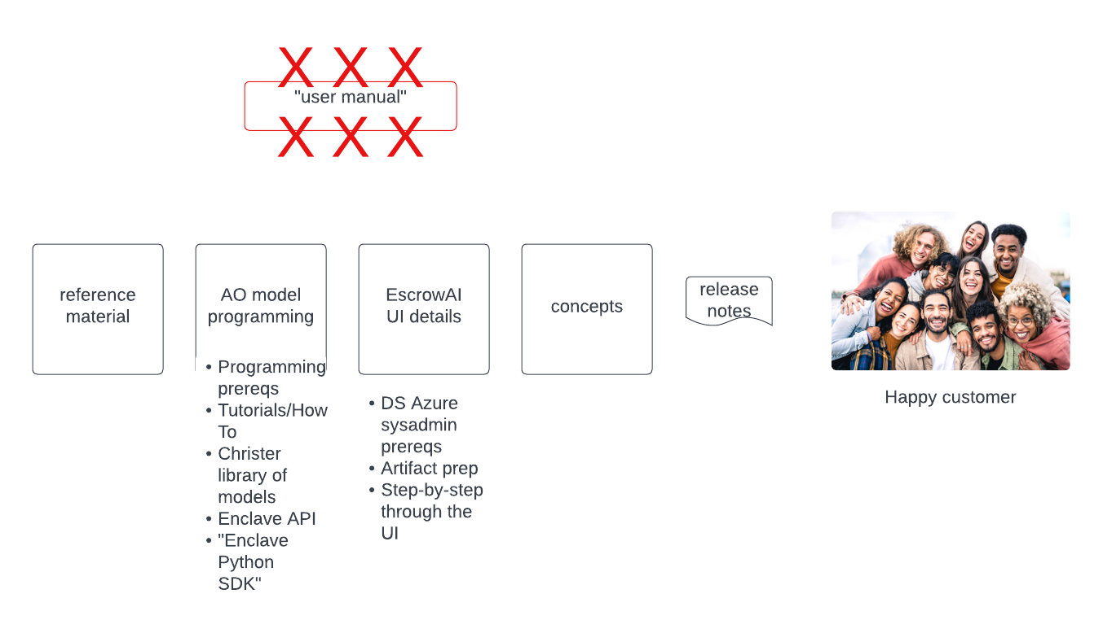
What is a documentation set?

Slide 3
2.0 docs as of 2024-01-122
In review
High-level description of support for CVM
High-level description of Model training and validation in EscrowAI
Define run configuration, send run request
Steps for run config
Steps for run request
In progress
Alex’s other tickets with focus on 1:M
Christer’s models
Major doc blockers:
Lack of firm design for 1:M
Does DS need a delegated subnet for CC ACI?
More features in the pipeline needing doc?

